Slide 1
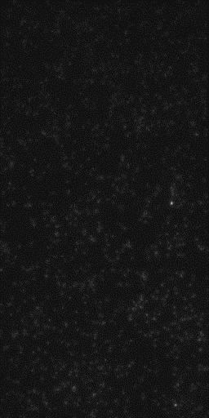
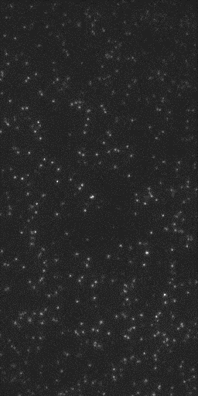
Double Round of Size Exclusion Chromatography
SNAREs only
10 µM α-syn

